Slide 1


Serverless Architectures and related services

Slide 2
In this section, we will discuss:
Serverless Architectures
What is the cloud provider’s role in serverless?
Why use serverless architectures?
How does Serverless Architectures Work?
Function-as-a-Service (FaaS)
Popular Serverless Platforms
Serverless Architecture Use Cases
Advantages of using serverless architecture
Limitations serverless architecture

Slide 3
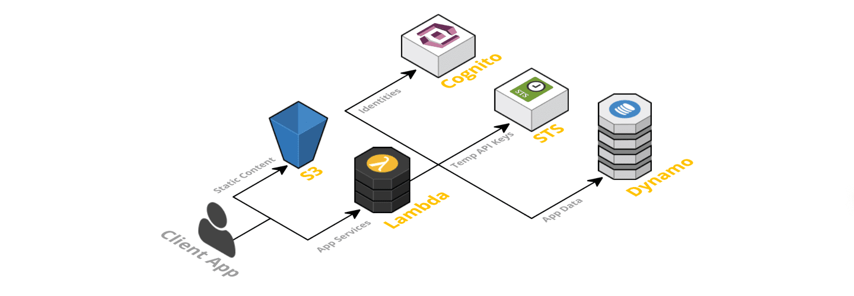
Serverless Architectures
Definition
A serverless architecture is a way to build and run
applications and services without having to
manage infrastructure.
Image Source:
https://www.simform.com/blog/serverless-architecture-guide/

Slide 4
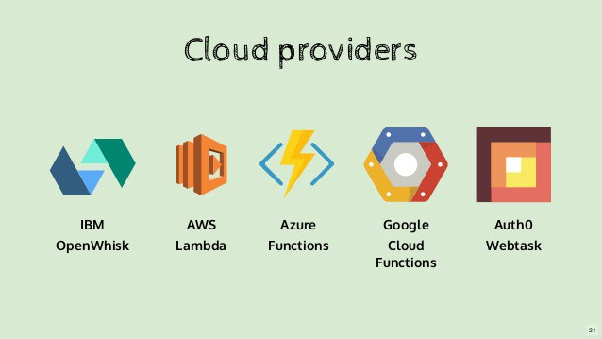
Serverless Architectures
Cloud provider’s role in serverless
A cloud provider runs physical servers and dynamically allocates their resources on behalf of users who can deploy code straight into production.
Image Source: https://avishwakarma.medium.com/serverless-101-6cf0ea769dde

Slide 5
Serverless Architectures
Why use serverless architectures?
By using a serverless architecture, developers can focus on their core product instead of worrying about managing and operating servers or runtimes, either in the cloud or on-premises.

Slide 6
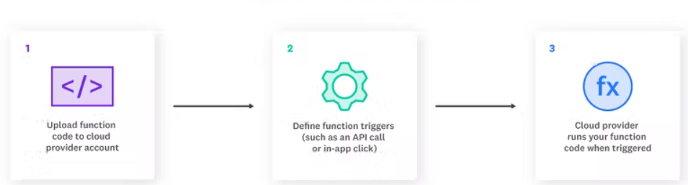
Serverless Architectures
How does Serverless Architectures Work?
The steps are:-
The developer writes a function.
The developer defines an event.
The event is triggered.
The function is executed.
The result is sent to the client.
Image Source: https://www.datadoghq.com/knowledge-center/serverless-architecture/

Slide 7
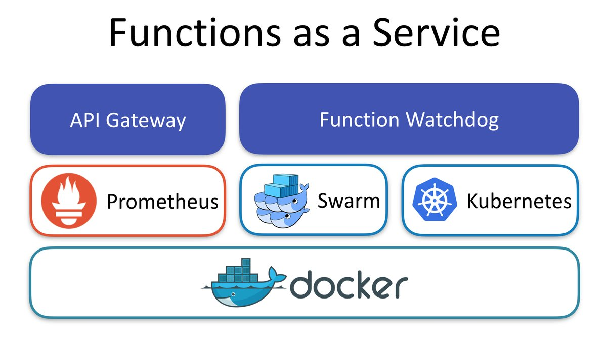
Serverless Architectures
Function-as-a-Service (FaaS)
Function-as-a-Service (FaaS) is an event-driven computing execution model where developers write logic that is deployed in containers fully managed by a platform, then executed on demand.
Image Source: https://kapuablog.wordpress.com/2017/08/10/introducing-functions-as-a-service-faas-dzone-cloud/

Slide 8
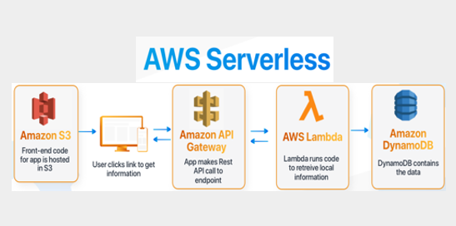
Serverless Architectures
Popular Serverless Platforms
Serverless Services on AWS - AWS Lambda is a serverless compute service that lets us run our code without provisioning or managing servers.
Image Source: https://www.xenonstack.com/blog/aws-serverless-computing/

Slide 9
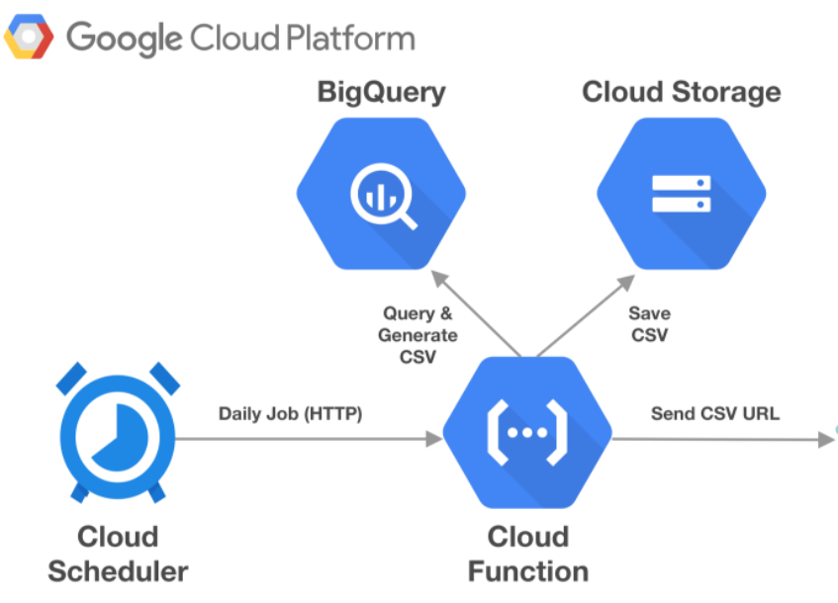
Serverless Architectures
Popular Serverless Platforms
Serverless Services on GCP - GCP, Cloud Functions is the key serverless product.
Image Source: https://www.alfianlosari.com/posts/serverless-reporting-notification-service-with-google-cloud-scheduler-and-functions/

Slide 10
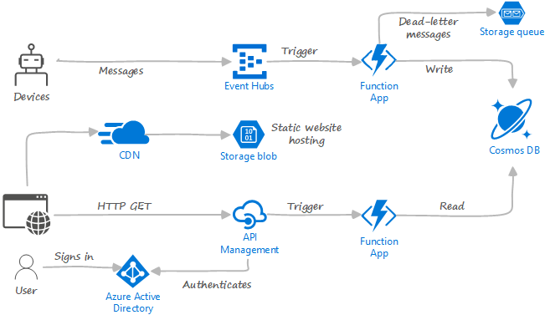
Serverless Architectures
Popular Serverless Platforms
Serverless Services on Azure - Microsoft Azure offers a FaaS service Azure Functions that provides an event-driven serverless compute platform.
Image Source: https://docs.microsoft.com/en-us/azure/architecture/serverless/code

Slide 11
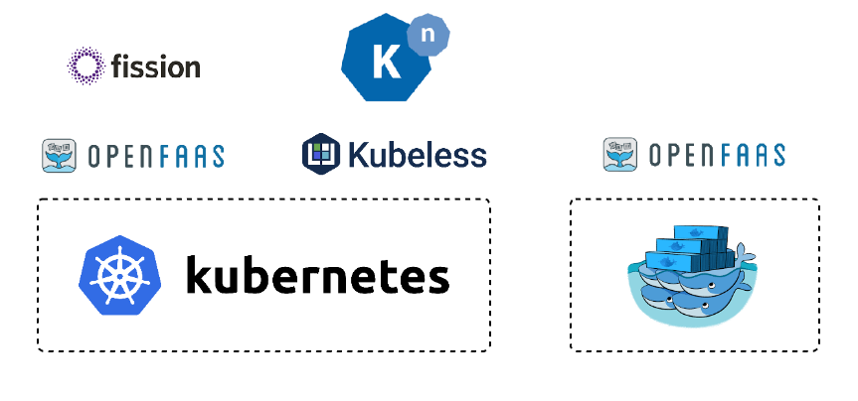
Serverless Architectures
Popular Serverless Platforms
Serverless on Kubernetes - Kubernetes is an open-source orchestration system for automating deployment, scaling, and management of containerized workloads.
Image Source: https://betterprogramming.pub/serverless-on-kubernetes-354051a1942e?gi=fac1eda8be88

Slide 12
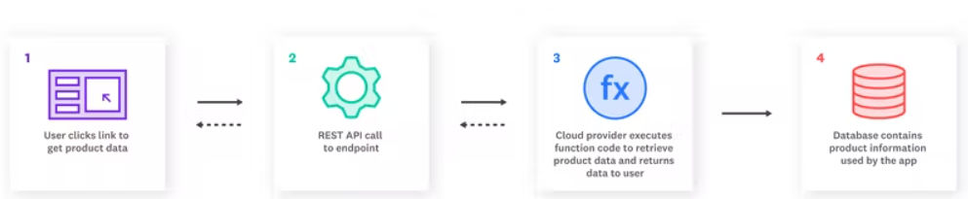
Serverless Architectures
Serverless Architecture Use Cases
The main use cases for serverless include:
Trigger-based tasks
Building RESTful APIs
Asynchronous processing
Security checks
Continuous Integration (CI) & Continuous Delivery (CD)
Image Source: https://www.datadoghq.com/knowledge-center/serverless-architecture/

Slide 13
Serverless Architectures
Advantages of using serverless architecture
Decomposing drives better observability
Serverless uses an event-based system versus stream-based
Faster deployments, greater flexibility, and accelerated innovation
Reducing architecture costs
Focusing more on UX

Slide 14
Serverless Architectures
Limitations of serverless architecture
Long-running application inefficiencies
Third-party dependency
Cold starts

